Slide 1



ONLINE BANQUET MANAGEMENT SYSTEM

Slide 2


INTRODUCTION
The aim of ‘Online Banquet Management System’ is to automate its existing manual system by the help of computerized equipment and full-fledge computer software, fulfilling their requirements so that their valuable date can be stored for a longer period with easy accessing and manipulation of the same. Basically the project describes how to handle good performance and provide better services to clients. This project can lead to error free, secure, reliable and fast management system. This system will help the organization in better utilization of resources.
Banquet Management System is the application of project management to the creation and development of small and/or large-scale personal or corporate events such as festivals, conferences, ceremonies, weddings, formal parties, concerts, or conventions.

Slide 3

OBJECTIVES
The objective of this project is to provide an interface where it helps the customer to analyze a venue for different types of ceremony’s anywhere anytime
·The venue’s which are registered here are around Belgaum location and it tells that it is available at that time or no.
·It is user friendly interface where it can provide easy options to and for the customer.
·It provides an interface where it allows user to search any venue based on there requirements and can compare the cost with the other one’s.

Slide 4
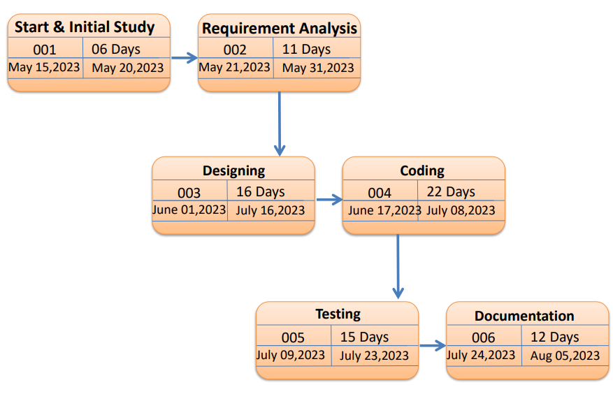
PERT CHART

Slide 5
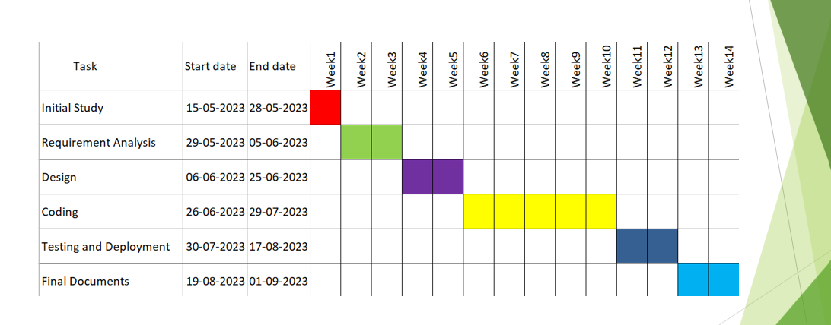
GANT CHART

Slide 6

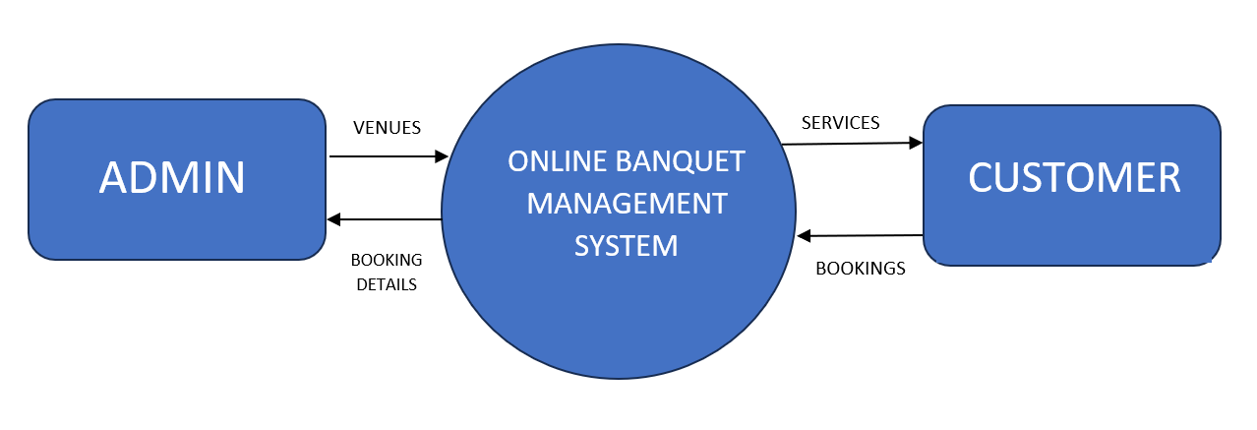


CONTEXT LEVEL DFD
Dani Martinez

Slide 7
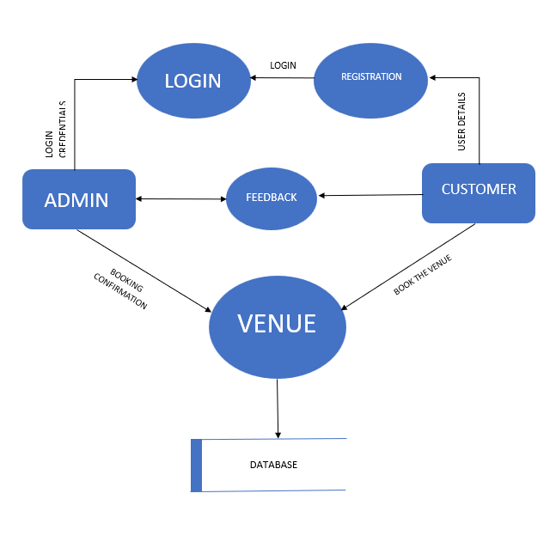
TOP LEVEL DFD
Dani Martinez
Alfredo Torres

Slide 8
HARDWARE REQUIREMENTS
·Hard disc : 4 GB min
·Operating System : Windows 7 or Above.
·Processor : Dual Core or Above.
·Processor speed : 1.5 GHz
·Internet Availability : Wifi , Ethernet etc.

Slide 9
SOFTWARE REQUIREMENTS
·Frontend Language : Html, JQuery, JavaScript
·Backend Language : PHP
·Web Browser : Any
·Database : MySQL
Server : XAMP

Slide 10

CONCLUSION
The aim behind this project is to create a web application that will help customer / user to book a venue whenever needed. It is also flexible for future enhancement of “Online Banquet Management System” as it makes a convenient use to the customer.

Slide 11

THANK YOU

